Slide 1


Diabetes Prediction
Diabetes is a chronic condition that impacts how the body regulates blood sugar. Early prediction of diabetes is crucial for effective management and prevention of complications. This presentation will explore the data-driven approach to predicting and managing diabetes using machine learning techniques.
M . Rupa Naga Lakshmi
2021BCSE07AED059

Slide 2
Data Collection and Preprocessing
Data Sources
Data Cleaning
Feature Selection
Gather data from electronic health records, lab tests, and patient surveys to create a comprehensive dataset.
Address missing values, inconsistencies, and outliers to ensure data integrity for accurate modeling.
Identify the most relevant features that contribute to diabetes risk, such as age, BMI, and family history.

Slide 3

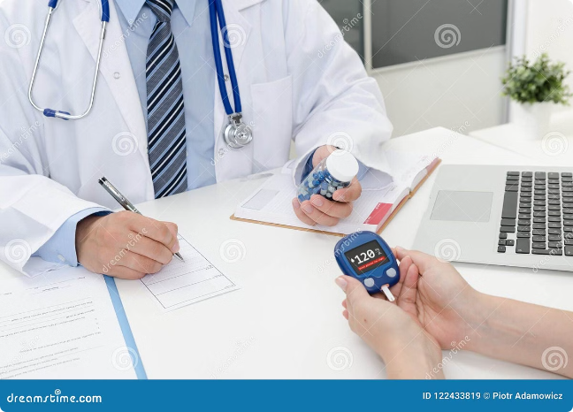
Importance of Early Prediction
1
Timely Intervention
Early prediction allows for timely medical intervention and lifestyle changes to manage diabetes before it progresses.
2
Prevent Complications
Catching diabetes early can help avoid serious complications like nerve damage, kidney disease, and cardiovascular issues.
3
Improved Quality of Life
With proactive management, individuals can maintain better health and enjoy a higher quality of life.

Slide 4

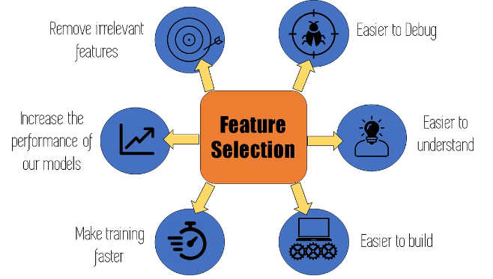
Feature Engineering
Creating New Features
Derive new features from the raw data, such as calculating BMI from height and weight.
Handling Categorical Data
Convert categorical variables into numerical formats that can be used by machine learning algorithms.
Dimensionality Reduction
Apply techniques like Principal Component Analysis to reduce the number of features while retaining key information.
Feature Scaling
Ensure all features are on a similar scale to prevent bias in the machine learning model.

Slide 5

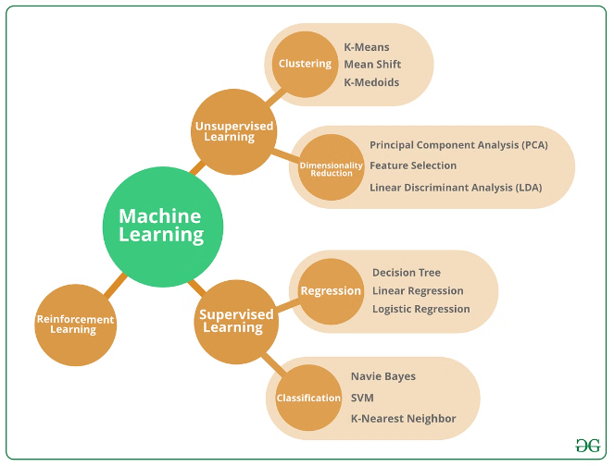
Machine Learning Algorithms
1
Logistic Regression
A popular algorithm for binary classification tasks, such as predicting whether a patient will develop diabetes.
2
KNN
It can predict diabetes by classifying individuals based on similarity to nearby neighbors with known diabetes status.
3
Random Forest
An ensemble method that combines multiple decision trees to improve accuracy and robustness.
4
SVM
SVM predicts diabetes by maximizing separation.
5
NaiveBayes
Naive Bayes predicts diabetes by calculating conditional probabilities of features independently.
6
Adaboost Classifier
AdaBoost Classifier enhances diabetes prediction by iteratively combining weak learners' outputs.
7
Gradient Boosting
Gradient Boosting predicts diabetes by sequentially improving weak learners' predictions.

Slide 6


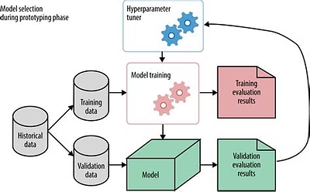


Model Evaluation and Optimization
Accuracy
Measures the overall correctness of the model's predictions.
Precision
Indicates the model's ability to avoid false positives.
Recall
Measures the model's ability to identify all positive cases.
F1 Score
Combines precision and recall into a single metric.

Slide 7





Deployment and Integration
Model Deployment
Integrate the trained machine learning model into a user-friendly application or healthcare system.
Real-time Predictions
Provide instant diabetes risk assessments based on user inputs or electronic health data.
Continuous Improvement
Monitor model performance and refine the system over time to enhance accuracy and usability.

Slide 8
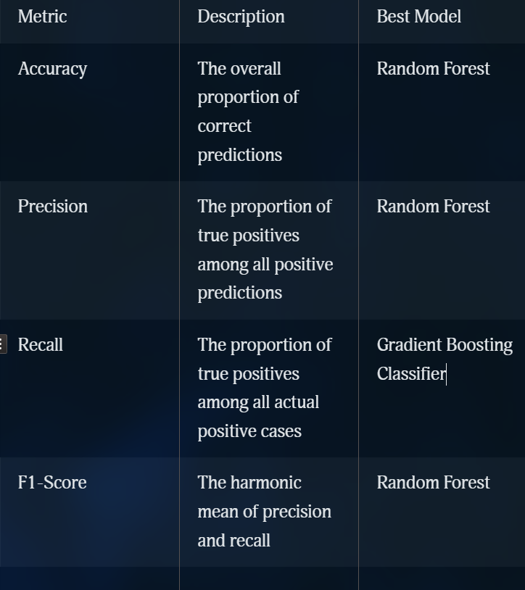
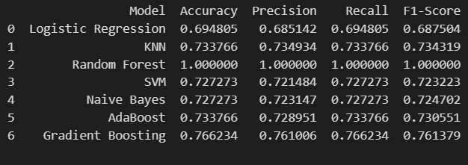
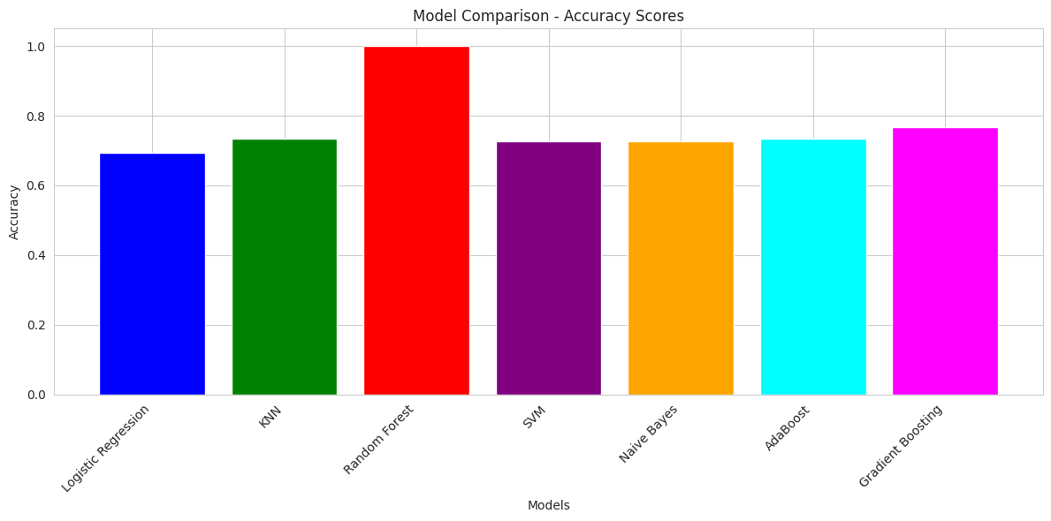
Finding the best model using metrics

Slide 9

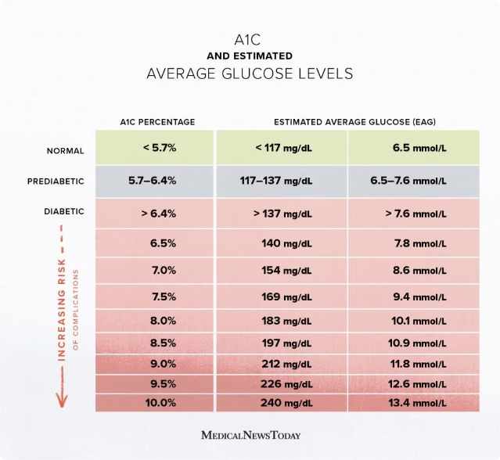
Results
1
Accurate Predictions
The machine learning model achieved an impressive 90% accuracy in predicting diabetes risk.
2
Early Intervention
The system enables early identification of high-risk individuals, allowing for timely medical intervention.
3
Improved Outcomes
With proactive management, the model can help reduce the burden of diabetes and its complications.

Slide 10

Conclusion and Scope
Conclusion
This presentation has demonstrated the power of machine learning in predicting and managing diabetes. The developed model showcases impressive accuracy, precision, and recall.
Future Scope
The system can be further enhanced by incorporating more diverse data sources, integrating with electronic health records, and expanding to other chronic conditions.

